Slide 1
Valence and Arousal
Estimation for
Video Events
Giulia Bertazzini
Niccolò Guiducci
Firenze, 7 Aprile 2023

Slide 2
Goals
Generate video events from RGB videos, labeled with valence and arousal
Estimate valence and arousal values on video events

Slide 3
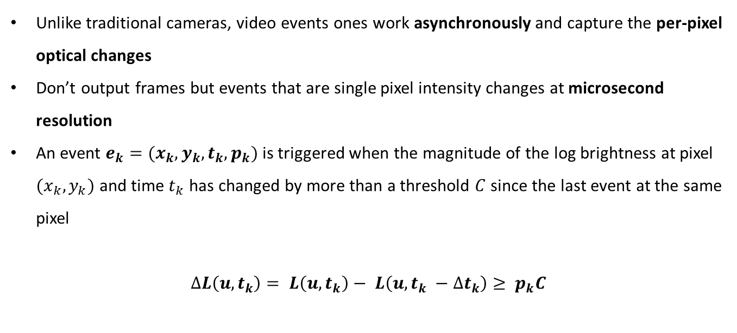
Introduction
Video Events
Unlike traditional cameras, video events ones work asynchronously and capture the per-pixel optical changes
Don’t output frames but events that are single pixel intensity changes at microsecond resolution
An event $e_{k}=(x_{k},y_{k},t_{k},p_{k})$ is triggered when the magnitude of the log brightness at pixel $(x_{k},y_{k})$ and time $t_{k}$ has changed by more than a threshold $C$since the last event at the same pixel
$$∆L\left(u, t_{k}\right)= L\left(u, t_{k}\right)− L\left(u, t_{k} −∆t_{k}\right)≥ p_{k}C$$

Slide 4
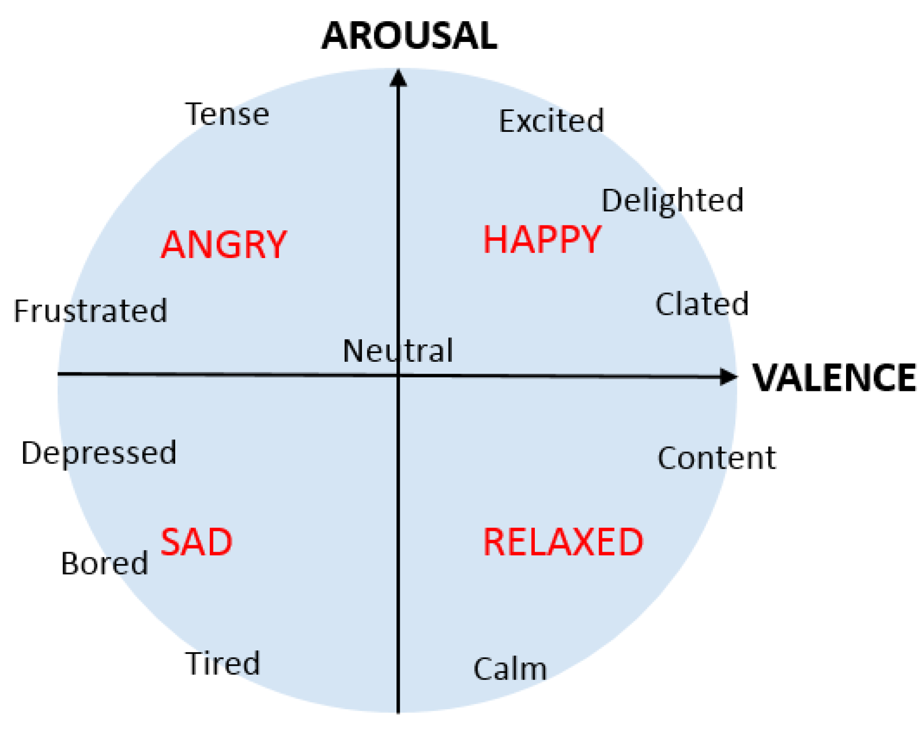
Introduction
Valence and Arousal
Emotional experiences can be described by two terms:
VALENCE: a scale that measures the positive or negative affectivity (so the pleasantness or unpleasantness of something)
AROUSAL: is a measure of how calming or exciting the information is

Slide 5




Implementation
In order to estimate valence and arousal on video events, first of all we generated the events starting from RGB videos
Then, we implemented a model which given an input video event, it returns an estimate of valence and arousal on this one
Main Implementation Tools
ESIM Simulator
Python
PyTorch framework
CUDA
TensorBoard

Slide 6
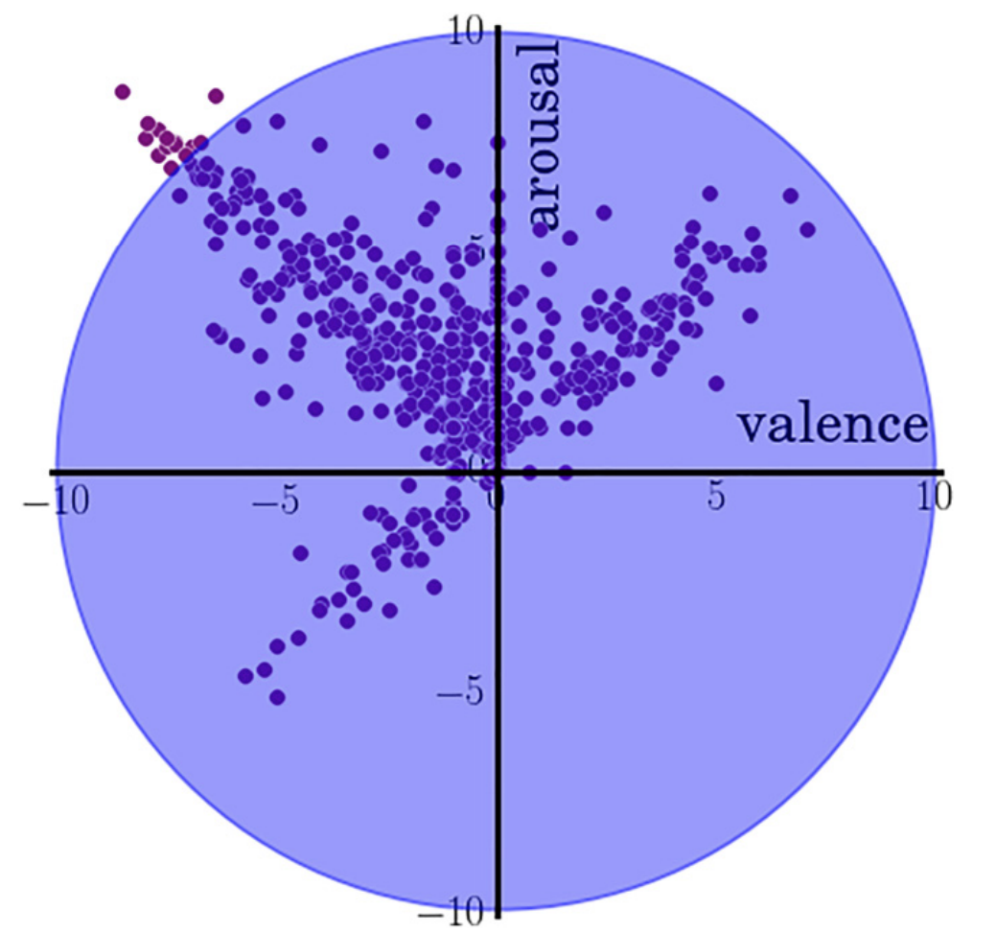
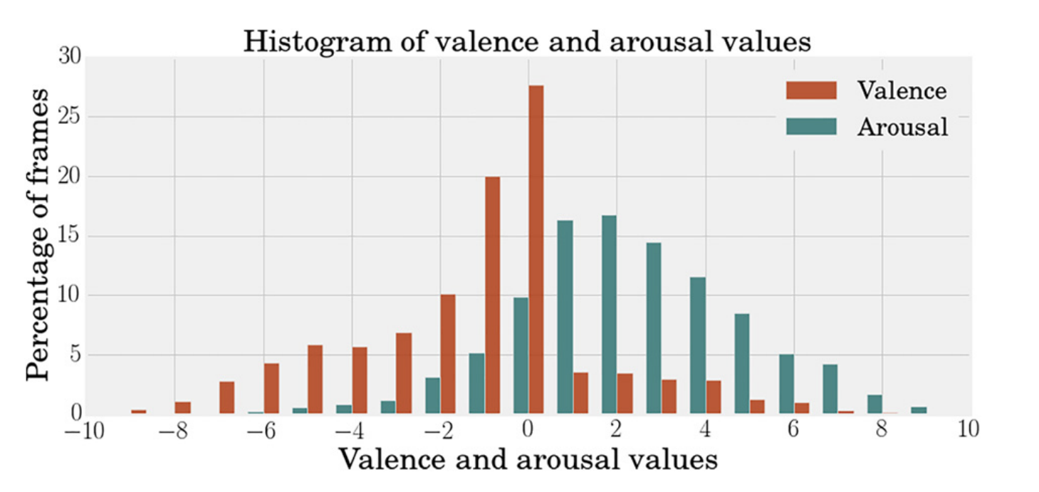
Implementation – Dataset
AFEW-VA Dataset
Collection of 600 RGB videos extracted from features films
Each video contains per-frame annotations levels of valence and arousal (which are discrete values in the range of -10 to 10), along with per-frame annotations of 68 facial landmarks.
Videos range from around 10 frames to longer clips (more than 120 frames); in total, there are 30,000 frames in the entire dataset

Slide 7


Implementation – Video Preprocessing
From RGB Videos to Video Events with ESIM Simulator
First of all, we cropped each frame of the RGB videos around the subject’s face (thanks to the facial landmarks provided by AFEW-VA dataset) to make them squared of size 200x200
After that, we also applied an image rotation on each cropped frame in order to make all the faces in the dataset oriented in the same way, i.e. faced to the camera
CROPPED AND ROTATED FRAME
ORIGINAL FRAME

Slide 8
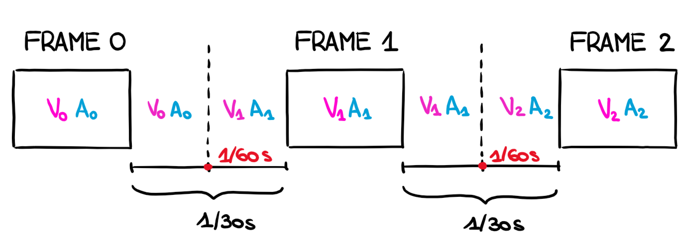
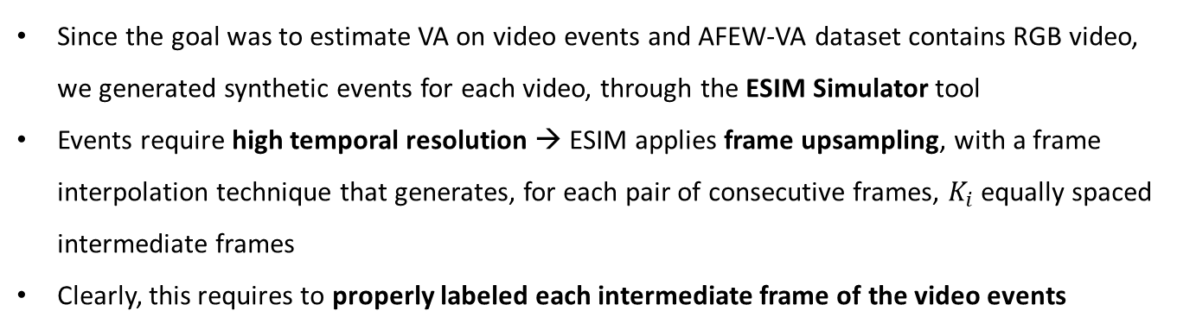
Implementation – Video Preprocessing
From RGB Videos to Video Events with ESIM Simulator
Since the goal was to estimate VA on video events and AFEW-VA dataset contains RGB video, we generated synthetic events for each video, through the ESIM Simulator tool
Events require high temporal resolution → ESIM applies frame upsampling, with a frame interpolation technique that generates, for each pair of consecutive frames, $K_{i}$ equally spaced intermediate frames
Clearly, this requires to properly labeled each intermediate frame of the video events

Slide 9
Implementation – Video Preprocessing
From RGB Videos to Video Events with ESIM Simulator

Slide 10
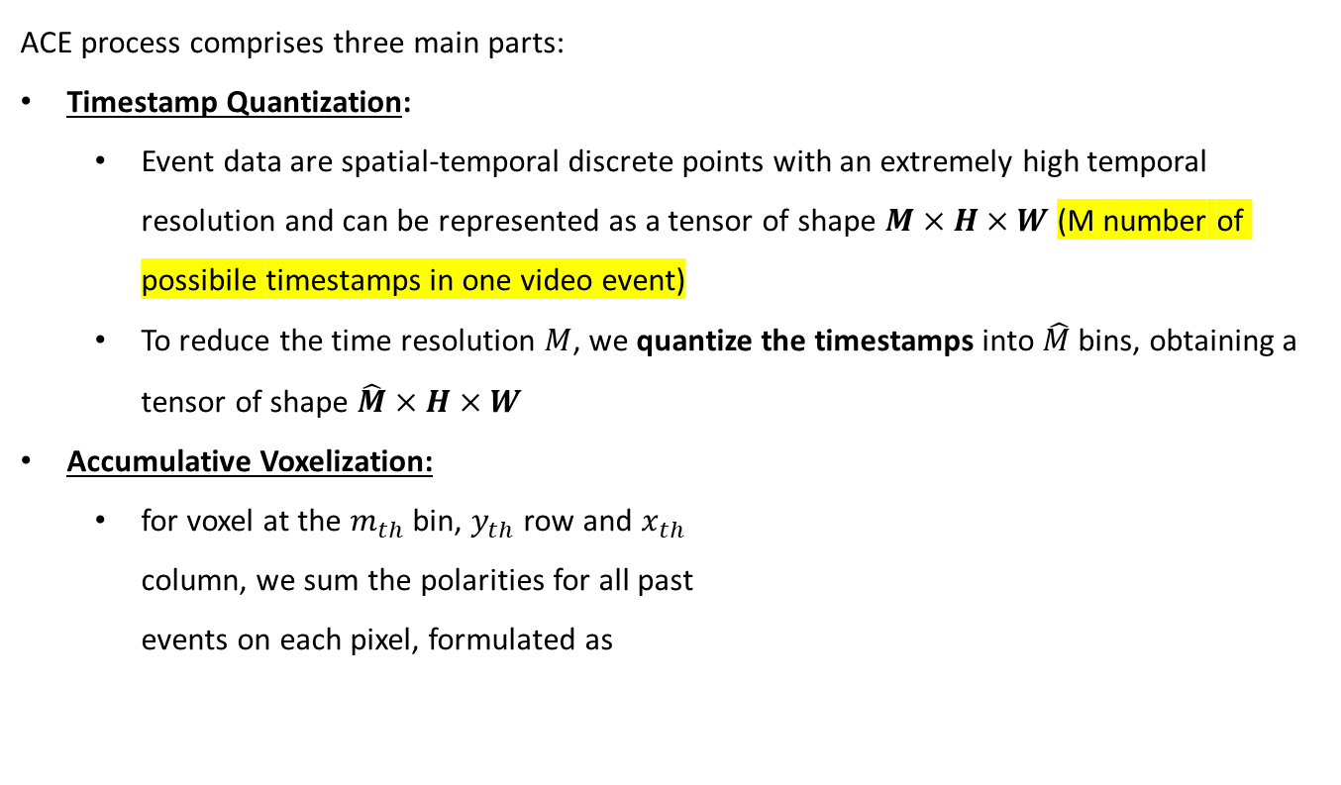

Implementation
Aligned Compressed Event
ACE process comprises three main parts:
Timestamp Quantization:
Event data are spatial-temporal discrete points with an extremely high temporal resolution and can be represented as a tensor of shape $M×H×W$ (M number of possibile timestamps in one video event)
To reduce the time resolution $M$, we quantize the timestamps into $\hat{M}$bins, obtaining a tensor of shape $\hat{M}×H×W$
Accumulative Voxelization:
for voxel at the $m_{th}$ bin, $y_{th}$ row and $x_{th}$ column, we sum the polarities for all past events on each pixel, formulated as
$$𝓥\left(m,y,x\right)=\sum_{j=1}^{n}{𝕀\left(x_{j}=x, y_{j}=y, τ_{j}≤m\right)∙p_{j}}$$

Slide 11
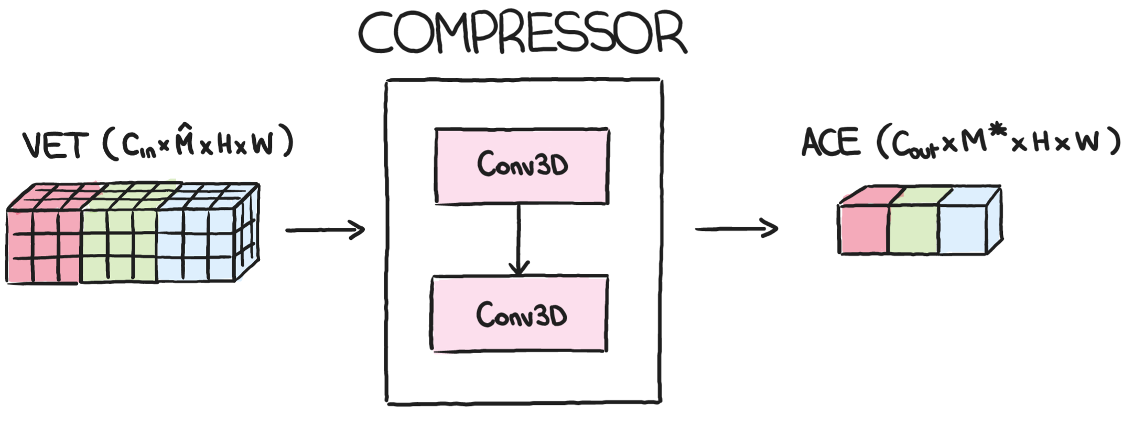
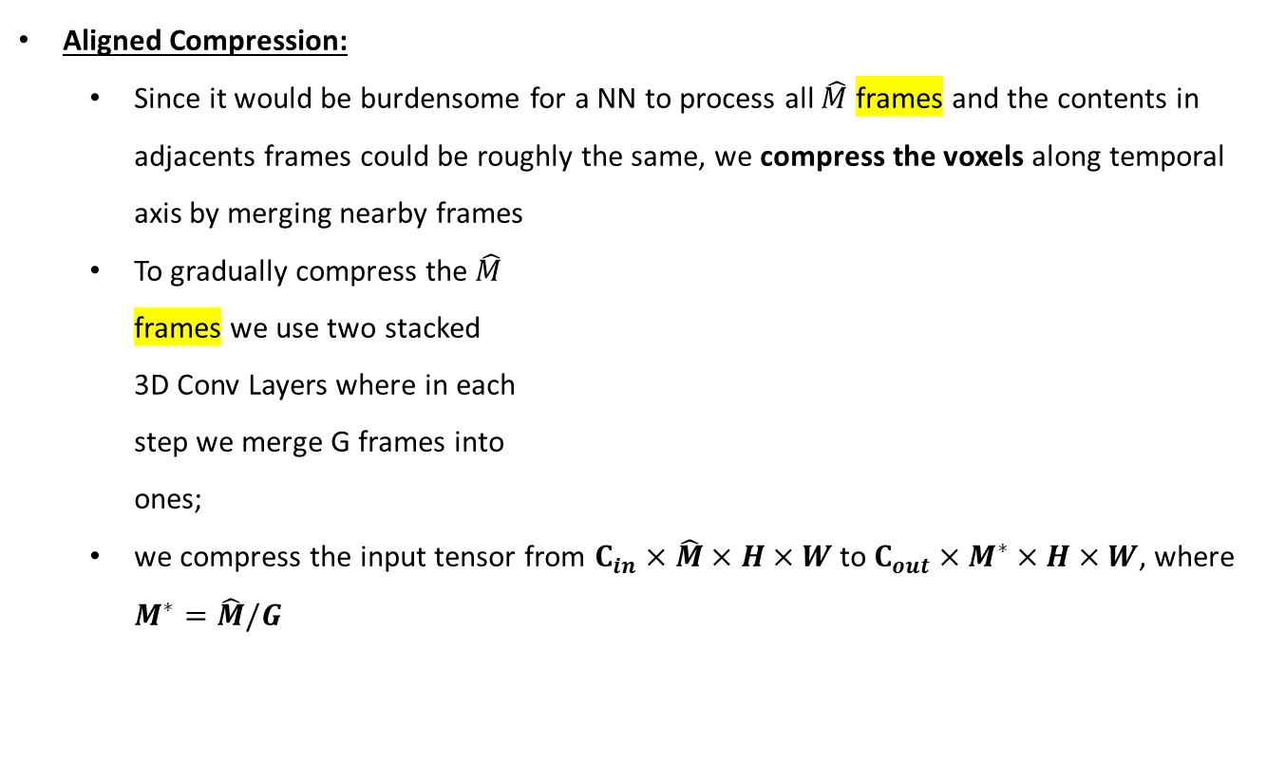
Implementation
Aligned Compressed Event
Aligned Compression:
Since it would be burdensome for a NN to process all $\hat{M}$ frames and the contents in adjacents frames could be roughly the same, we compress the voxels along temporal axis by merging nearby frames
To gradually compress the $\hat{M}$ frames we use two stacked 3D Conv Layers where in each step we merge G frames into ones;
we compress the input tensor from $C_{in}×\hat{M}×H×W$ to $C_{out}×M^{∗}×H×W$, where $M^{∗}=\hat{M}/G$

Slide 12
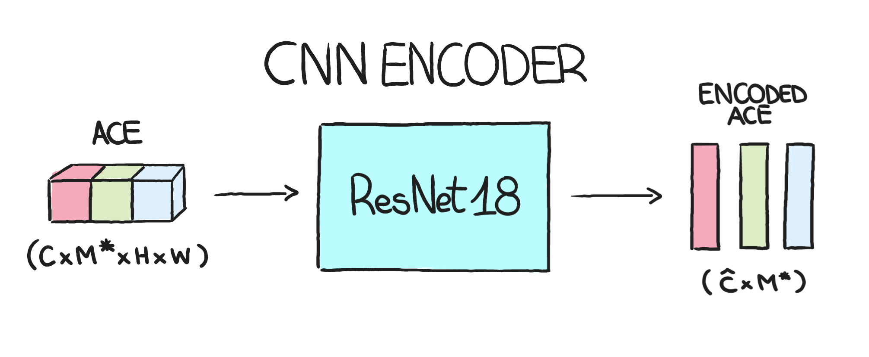
Implementation
Model Architecture – Branch Event Net
BET processes the ACE-encod event data to estimate valence and arousal values. It is designed to be versatile for both static and dynamic scenes
CNN Encoder

Slide 13
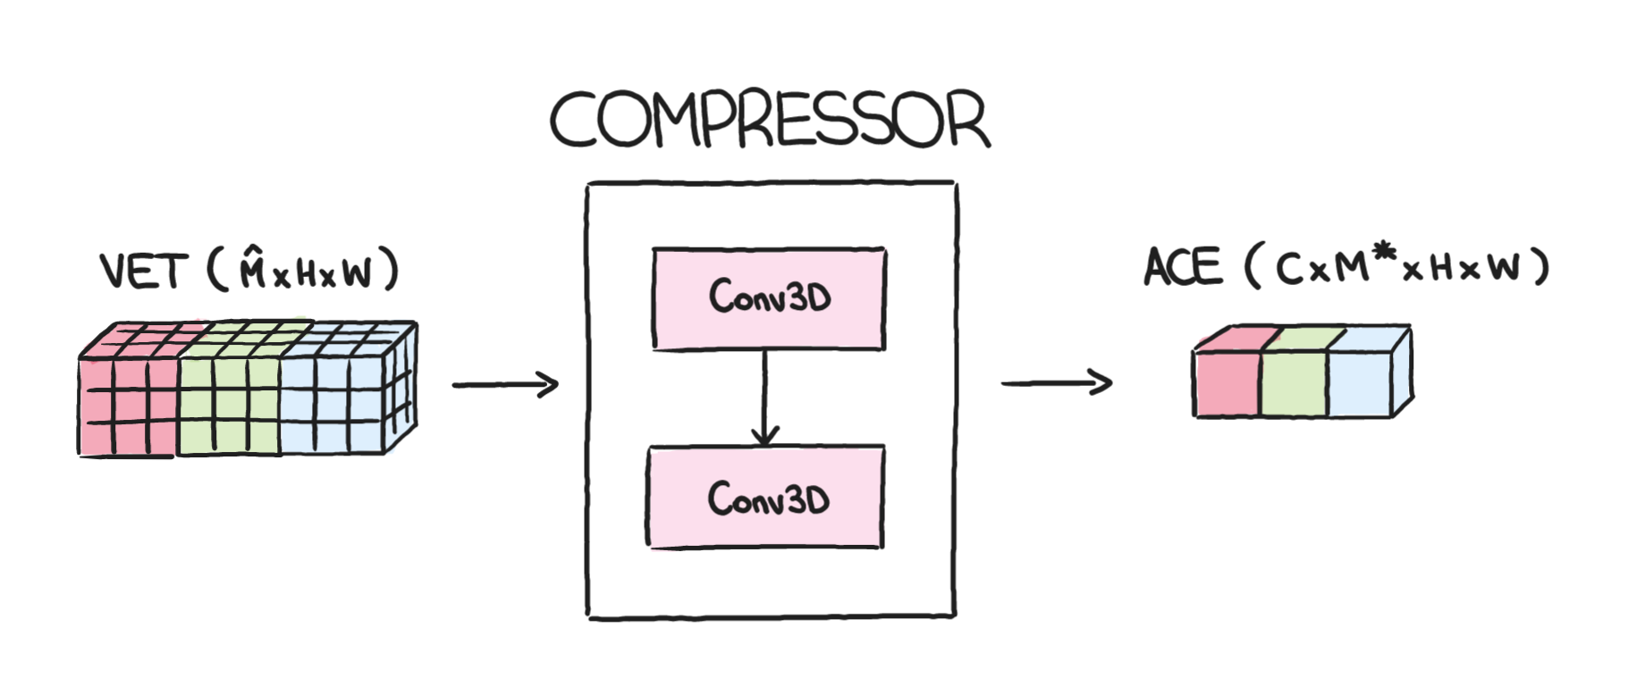
Implementation
Model Architecture – Branch Event Net

Slide 14
Experiments and Results
text

Slide 15
Conclusions

Slide 16
Title
Giulia Bertazzini
Niccolò Guiducci
Firenze, 7 Aprile 2023

